Slide 1

External Relations Division
January 11, 2018
Labor Market Trends
Texas

Slide 2
Unemployment Rates – Texas & US
Seasonally Adjusted, November 2005- Current
Notes:
Texas reversed a long running trend before 2007 when the U.S. had a lower overall unemployment rate than Texas. Since then, however, Texas has had a lower unemployment rate than the U.S., except for a portion of 2016. Recently, the unemployment rate in October 2017 stood at 3.9 percent, the lowest unemployment rate in the history of the that began in 1976.
The unemployment rates have been really low. This is when labor shortages start to occur. Employers are complaining that they can’t find and retain qualified applicants.
Economic theory states virtual full employment is 3-5 percent.

Slide 3
Annualized Employment Growth
(Seasonally Adjusted) November 2005 - Current
Notes:
Now let’s look at growth. This is annual percentage growth, it is a better indicator than looking at monthly growth because it is less volatile. The US currently stands at 1.4% annual growth, while Texas is at 2.7 percent. Ideal or sustainable economic growth is often considered to be between 2 and 3 percent. So Texas has been posting sustainable growth.
Texas had made a solid recovery from Oil and Gas job slowdown in 2015, But really, overall, the other industries haven’t slowed down.

Slide 4
Employment Recovery from Economic Downturn
Seasonally Adjusted, Indexed to Pre-Downturn Peaks
Notes:
This graph is indexed to pre-recession peaks.. It just means that the peak of growth prior to the 2008 economic downturn equals 100 percent.
Texas emerged with much stronger growth than the US and most areas in the country. So Texas has grown 16.6 percent more than that peak it had attained back in 2007. There are some metro areas within Texas that have surpassed this growth, one example is DFW, which has grown 18 percent over the pre-recession peak.

Slide 5
Annual Job Growth and U-Rates for Texas Metros
(Not Seasonally Adjusted), November 2017
Rank | Metropolitan Area | Annual Job Growth Rate | Unemployment Rate
1 | College Station-Bryan | 3.7% | 2.7%
2 | San Antonio-New Braunfels | 3.0% | 3.0%
3 | Corpus Christi | 2.9% | 5.3%
4 | Dallas-Plano-Irving | 2.9% | 3.1%
5 | Austin-Round Rock | 2.7% | 2.7%
6 | Fort Worth-Arlington | 2.7% | 3.2%
7 | El Paso | 2.6% | 4.0%
8 | Odessa | 2.4% | 3.4%
9 | Midland | 2.4% | 2.6%
10 | McAllen-Edinburg-Mission | 2.3% | 6.2%
11 | Killeen-Temple | 2.0% | 3.6%
12 | Longview | 1.6% | 4.2%
13 | Houston-The Woodlands-Sugar Land | 1.6% | 4.3%
14 | Tyler | 1.4% | 3.5%
15 | Amarillo | 1.3% | 2.6%
16 | Wichita Falls | 1.0% | 3.3%
17 | Lubbock | 1.0% | 2.7%
18 | Laredo | 0.9% | 3.4%
19 | Victoria | 0.5% | 4.1%
20 | San Angelo | 0.4% | 3.1%
Notes:
These are the metro areas ranked by annual growth rate. It’s not unusual to see the larger MSAs make the top because of the size, but here we have the College Station-Bryan MSA rank #1. Midland and Amarillo have the lowest unemployment rates, at 2.6 percent. Followed by Austin and College Station-Bryan with a 2.7 percent unemployment rate.
We are here at what many economists would refer to full employment which sometimes is estimated to be between 3 and 5 percent. This is when you start having a skills gap problem because it is harder for companies to find skilled applicants and there is a higher pressure for re-training of the local workforce.
This also puts upwards pressure on wages to attract and retain qualified workers.

Slide 6
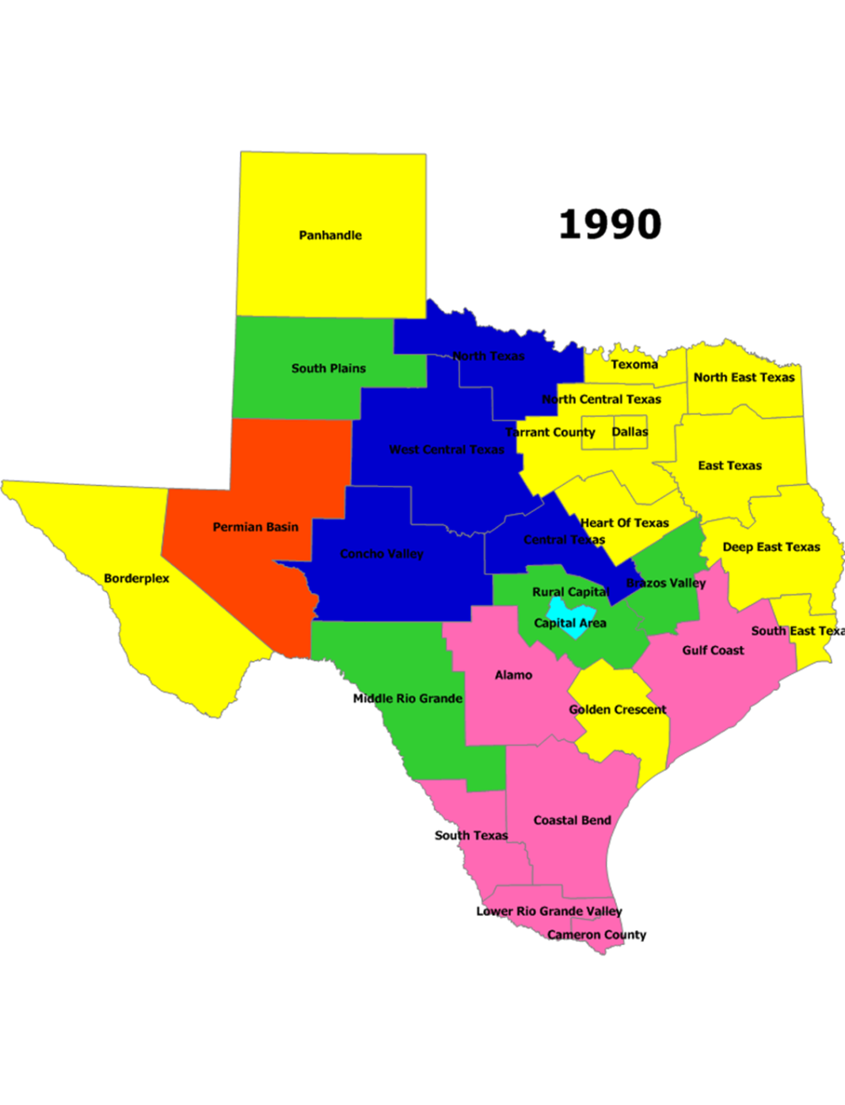
Top Industry by Employment
Mining, Oil and Gas
Manufacturing
Transportation & Warehousing
Public Administration
Health Care & Social Assistance
Education Services
Retail Trade
Notes:
This is a map of the 28 Workforce Board areas in Texas, classified by the #1 industry of employment, the industry that employs the most people. We took this data back to 1990. To the left you’ll see the 7 big industries color coded. As we can see in 1990, Manufacturing was the #1 industry of employment in Texas.
I’d like for you to focus on three main colors.
Yellow - Mfg
Navy Blue – Healthcare
Pink – Retail Trade
Let’s see how things change over time.

Slide 7

Top Industry by Employment, 1990-2016
Mining, Oil and Gas
Manufacturing
Transportation & Warehousing
Public Administration
Health Care & Social Assistance
Education Services
Retail Trade
Notes:
As we can see, the Healthcare industry is by far the fastest growing industry of employment in Texas. It is actually the #1 industry in 47 of the 50 states
(Alaska, Hawaii, Nevada – Hospitality and Tourism is their #1 industry)

Slide 8
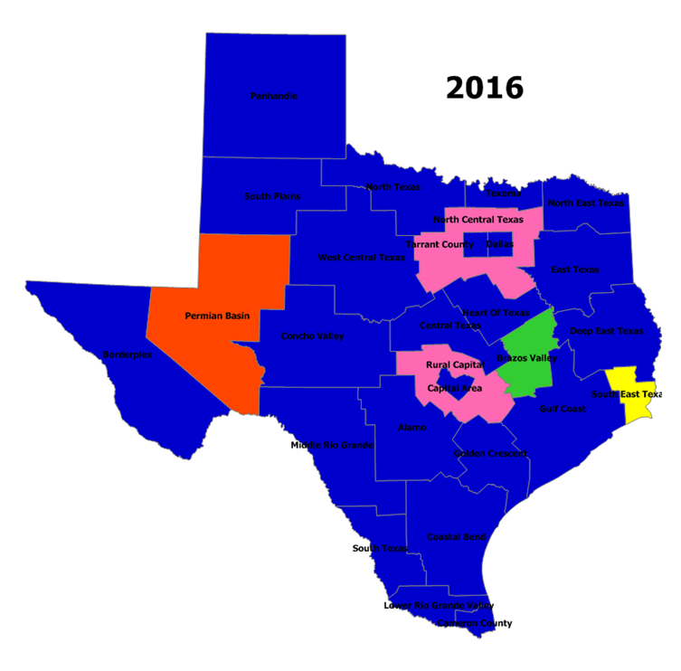
Top Industry by Employment
Mining, Oil and Gas
Manufacturing
Transportation & Warehousing
Public Administration
Health Care & Social Assistance
Education Services
Retail Trade
Notes:
This is due to the demand caused by our aging population. As you can see the majority of the state is now dominated by health care.
The Texas industry makeup has not remained constant in the last 27 years, and that’s not really surprising.

Slide 9
Annual Growth Rates
Not Seasonally Adjusted, November 2017
Notes:
Here you see the industries posting the strongest annualized growth rates are in Mining and Logging (15.2%), which has picked up strong after employment losses in In 2015 and 2016, when the industry experienced mostly over-the-month declines due to the price of oil dropping over 70 percent.
Education Services (5.7%), and Manufacturing (4.5%).
Other Services (4.3%)
Financial Activities (4.0%)
Construction has good growth at 3.4%.
Healthcare and Social Assistance (2.0%)
Information (-6.5%)

Slide 10
Texas Industry Employment
(Seasonally Adjusted) November 2017
INDUSTRY SECTOR | Nov 2017* | Monthly Change | Yearly Change
Professional and Business Services | 1,700,600 | 14,700 | 56,500
Leisure and Hospitality | 1,348,500 | 8000 | 38,400
Manufacturing | 879,400 | 2,700 | 38,100
Government | 1,973,500 | 2,500 | 36,000
Mining and Logging | 248,900 | 1,300 | 32,800
Financial Activities | 768,300 | 3100 | 29,400
Health Care and Social Assistance | 1,483,400 | 6700 | 29,200
Local Government | 1,354,900 | 1,600 | 26,800
Construction | 729,400 | 8,200 | 23,900
Other Services | 447,800 | -800 | 18,500
Trans., Warehousing, & Utilities | 546,900 | 2,500 | 14,500
Educational Services | 208,800 | 1,500 | 11,200
Retail Trade | 1,330,100 | 6300 | 9,900
State Government | 415,600 | 400 | 6,000
Wholesale Trade | 591,400 | -600 | 5,300
Federal Government | 203,000 | 500 | 3,200
Information | 188,200 | -1,600 | -13,100
Notes:
The information industry looks like its losing a lot of jobs over the year. This industry employment estimates are often revised significantly during our benchmark period. It is the smallest supersector and the sample size we use to estimate the employment number is very small, so it possibly isn’t losing as much employment as we are seeing here. Retail has been also struggling over the year and has lost jobs annually.

Slide 11
Industry and Occupational
Projections
Notes:
So what we do with projections is compare a base year and to a target year that is 10 years later.
Projections are available for the State of Texas and the 28 workforce board areas.
2014-2024

Slide 12
Employment Growth by Industry Sector
Texas: 2014-2024
Service providing
Goods producing
Natural Resources & Mining
Notes:
Texas is projected to growth by 20.7 percent from 2014-2024.
Healthcare and Social Assistance #1 industry of employment in Texas.
Population growth. From 2010-2016 Texas added 2.7 million people, more than any other state in the nation.
Mining – 2014 base In 2015 and 2016 the industry experienced mostly over-the-month declines due to the price of oil dropping over 70 percent.
Construction is expected to 27.8%, the third fastest growing industry creating the need for 177,390 workers over 10 years.
These projections indicate that the highest demand will be for specialty trade workers, such as Electricians, Plumbers, and Carpenters.

Slide 13
Texas Construction Employment
Seasonally Adjusted, November 2017
Notes:
Here we have Construction employment graphed from 1990 to November 2017, the latest data available. We can see that Construction has grown steadily and continues to rise.
Home sales have risen significantly in Texas, inventories are trying to keep up. The average home prices have increased as well.
These types of trends indicate that we’ll continue to see a strong demand for residential, commercial and industrial building projects.

Slide 14
Electricians
2014 Employment by Major Industry Sector
69%
Notes:
Over 69 percent of Electricians are concentrated in the Construction industry. In 2024 the Construction industry will account for over 73% of electricians.

Slide 15
Employment by 6-digit Industry
Notes:
Here we dive a little deeper and look at 6-digit industries found in
Construction, Mining, and Manufacturing.
Electricians are mostly found in the Building Equipment Contractor industry, which stems from the Specialty Trade Contractors.

Slide 16
Electrician Occupation Wages by Industry
2016 Annual Average Wages
Notes:
Wages for Electricians across industries vary from $45,064 in Construction to a high of $59,621 in Financial Activities. Construction is where most of your Electricians are concentrated.
The 2016 average annual wage in Texas is $47,767.

Slide 17
Apprenticeable Occupations
Texas: 2014-2024
Annual Average Wage 2016
$46,412
$38,004
$46,096
$40,081
$42,816
$43,767
$37,873
$46,616
$43,683
$47,206
Notes:
Electricians has the largest employment (57,310) STW $47,767 20.7% median $35,484
Carpenters (51,000) +11,520
Plumbers, Pipefitters, & Steamfitters (37,630)
Sheet Metal Workers
Brickmasons & Blockmasons
Reinforcing Iron & Rebar Workers (3,800) +1,690
Insulation Workers, Mechanical
Structural Iron & Steel Workers
Millwrights 1,090
Glaziers

Slide 18
Projected Growth for Electricians in Texas
Notes:
Demand for Electricians is steadily growing. More than 15,000 additional electricians are expected by 2024, bringing the total to 73,240. This is mainly due to ever-increasing population and a growing number of baby boomers retiring.

Slide 19
Annual Job Openings in Texas
Electricians
Notes:
Each year, 2,470 electricians will be needed in Texas.
1595 due to growth and 875 due to replacements.

Slide 20
Annual Wages - Electricians
Notes:
Electricians earn well above the median for all occupations in Texas, do not requiring a college degree, and can be found in a variety of industries.
Average: 46,412 Texas Average: $47, 767

Slide 21
Job Postings
Notes:
Now we have access to “real-time labor market data”.
The idea behind this data is to use job-posting analytics to shed more light on the labor market by providing current data on employer demand.

Slide 22
Help Wanted Job Listings by MSAs
Electricians
MSA | OTY Change | Postings
Dallas-Fort Worth-Arlington, TX | ↑ | 1,787
Houston-The Woodlands-Sugar Land, TX | ↓ | 1361
San Antonio-New Braunfels, TX | ↑ | 463
Austin-Round Rock, TX | ↑ | 382
Beaumont-Port Arthur, TX | ↑ | 109
Amarillo, TX | ↑ | 104
Lubbock, TX | ↑ | 98
College Station-Bryan, TX | ↑ | 92
Corpus Christi, TX | ↑ | 88
Longview, TX | ↑ | 81
Midland, TX | ↑ | 76
McAllen-Edinburg-Mission, TX | ↑ | 73
Odessa, TX | ↑ | 70
El Paso, TX | ↓ | 68
Waco, TX | ↑ | 66
Notes:
Real-time data can give us an idea of what the current demand is for certain occupations like Electricians. The largest number of postings is in the larger MSAs as is to be expected. The most important thing is that for the most part the growth in the past year has been positive.

Slide 23
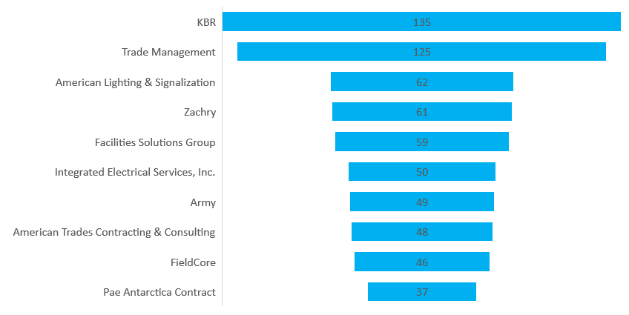
Top Employers in Texas
Electricians
Notes:
These are the employers that recently posted the most Electrician Jobs in Texas in the past year. These are the companies that have larger concentrations of job postings. There are many other postings but for smaller companies or contractors.
Last year there was almost 4,000 postings a year, if you add in Electrician helpers the total job postings a year goes up to over 6,000 jobs.

Slide 24
Skills
Notes:
Job postings not only tell us who the employers are but also give us specific and detailed information on the types of skills that employers want.

Slide 25
“Hard Skills” Most in Demand
Texas
Notes:
How to read and follow blueprints, knowledge of electrical systems and switches.

Slide 26
“Certificates” Most in Demand
Texas
Notes:
Driver’s License is by far the number one requested certification, followed by
National Electrical code certification and knowledge of local electrical codes.
NCCER electrical certification.
These certifications are considered an essential part of the job.

Slide 27

Rick Stephens, Boeing Corp
“There’s not one specific thing or skill people have to have to work for us. But I can tell you why we fire people: soft skills. We hire for hard skills. We fire for soft skills.” – Interviewed by TWC

Slide 28
“Soft Skills” Most in Demand
Texas
Notes:
This next slide shows us soft skills in demand. Troubleshooting and communication make the top.
We do have to keep in mind that job postings only represent a small part of the economic activity. It has seasonal shifts and the quality really depends on how well the job posting sites are scraped. So it’s important to use in conjunction with other LMI data to get the full picture.

Slide 29
Demographics

Slide 30
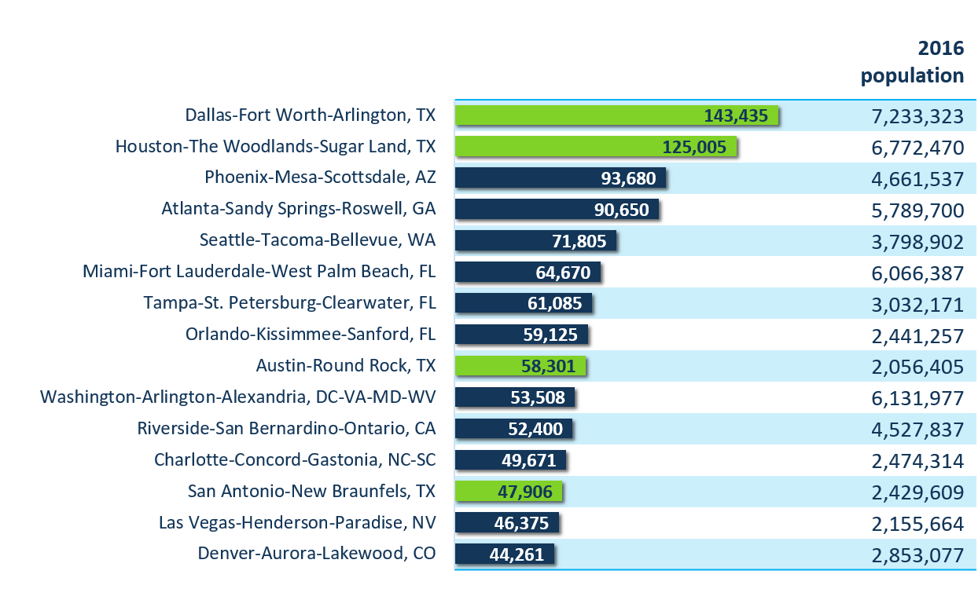
Metro Areas with Largest Population Gain
15 Largest Numeric Increases Between 2015 and 2016
Source: U.S. Census Bureau, American Community Survey and Population Estimates Program, 2015 Estimates
Notes:
It’s an important factor, as population growth is one of the variables that drive growth in all industries. Population growth a sign of economic vitality.
As you can see the DFW area tops the charts for largest population gain.
In all Texas has four of the fastest growing metro areas in the nation.

Slide 31
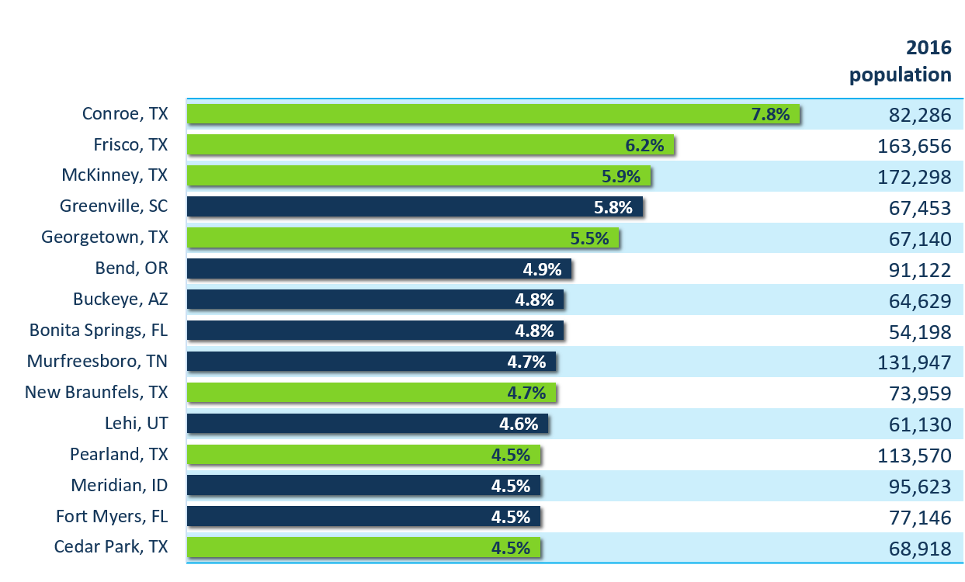
Fastest-Growing Cities Are
Deep in the Heart of Texas
15 Fastest-Growing Cities and Towns Between 2015 and 2016
Source: U.S. Census Bureau, American Community Survey and Population Estimates Program, 2015 Estimates
Notes:
Texas has become notorious in its ability to attract population growth in the US. According to the Census Bureau, 7 of the top 15 fastest growing cities are in Texas. As you can see high in the rankings are Frisco, McKinney and Pearland… all Dallas area cities
According to the Census, between 2015 and 2016, the Texas population grew at a faster rate than the nation. It added over 400,000 people, more than any other state.
A large population bodes well for future growth, it will grow the labor force and provide a large pool for employers to tap into.

Slide 32
Age Breakdown of Licensed Electricians
Source: U.S. Census Bureau, American Community Survey, 5-year Estimates
Notes:
It’s been an ongoing discussion that the hardest segment of the workforce for employers to staff is the skilled trades– the welders, electricians, machinists, etc. that are so prevalent in manufacturing and construction. Many worry that it be more difficult in the years to come due to retiring workers.
Almost 40% of the electrician workforce here in Texas is 45 years and older. (38.5%)
Data shows that almost all skilled workers stop working at the age of 65 due to the fact that these types of jobs are more physically demanding.

Slide 33
Education Level for Electricians
Source: U.S. Census Bureau, American Community Survey, 5-year Estimates
Notes:
Here is the education break-down of Electricians. As a skilled trade job a college degree is not needed, although people who perform electrical work must be licensed by the Texas Department of Licensing and Regulation (TDLR).
This is another reason, perhaps, that a shortage in skilled trade workers is expected. Both parents and counselors have put emphasis on pushing students towards a college or university degree, as opposed to training at a technical school or apprenticeships. The truth is that white collar jobs aren’t by default the highest paying jobs. We are about to release our Annual Report on Growth occupations, which detail high growth, in demand jobs, paying above the Texas median wage and the occupations range from skilled trades requiring technical skills to professional occupations.

Slide 34
Additional Resources

Slide 35

  Employers
  BUILD a highly skilled workforce
  PREPARE for a retiring workforce
  EARN business tax credits
  RETAIN qualified workers
  REDUCE turnover costs with a positive return on investment
  apprenticeshiptexas@twc.state.tx.us
Notes:
TWC is aware of the impending skilled workers shortage and through an ApprenticeshipUSA State Expansion Grant, Texas is developing and implementing strategies to support apprenticeship expansion. Partnering with industry and workforce employers not only to expand apprenticeship to new sectors, but also to underserved populations.
REGISTERED APPRENTICESHIP PROGRAMS prepare workers through specialized on-the-job training and provide employers with a high quality trained workforce that carries a nationally recognized industry certification.
There are many benefits to participating in an apprenticeship program it , helps recruit and develop a highly skilled workforce, you prepare for a retiring workforce, you earn tax credits, it helps reduce turnover costs and increasesemployee retention,
To get started ApprenticeshipTexas staff are ready to help you identify the apprenticeship model that best suits your business. When you e-mail us, you'll get, one-on-one technical assistance and guidance to get your program up and running.

Slide 36
  Apprentices
  EARN WHILE YOU LEARN
  Hands-on experience
  Build up your skills
  Over 1,200 apprenticeable occupations
  www.mynextmove.org
  apprenticeship@twc.state.tx.us
Notes:
EARN WHILE YOU LEARN!
Apprenticeship is on-the-job training under the supervision of experienced journeyworkers with related classroom instruction, resulting in a national occupation credential.
You can earn a paycheck and get hands-on experience while building up your skills
There are over 1,200 apprenticeable occupations, some of which are Advanced Manufacturing, Automotive, Construction, Electrical, and so on.
We direct students or those interested in learning more about registered apprenticeships & career options to go to www.mynextmove.org, a website sponsored by the DOL. You can not only explore careers by keywords and industry, but also look at careers that have apprenticeships programs registered with the DOL. They have an apprenticeship finder that lets you search by location.
Right now there’s about 90 apprenticeship sponsors registered in Texas.
You can always contact your state apprenticeship agency.
It’s important for employers to work together with the workforce board and local community colleges so they can come together to create training programs to get individuals trained/re-trained to meet the demand for the type of occupations they want.

Slide 37
Our Web Based Tools
Texas Career Check (www.TexasCareerCheck.com)
    Assess interests; explore job and education options
Reality Check (www.texasrealitycheck.com)
    Evaluate the cost of lifestyle choices; check out jobs and education requirements to support those choices
AutoCoder (http://autocoder.lmci.state.tx.us)
    Convert job descriptions, applications, resumes, other text to occupational titles; link to online job postings; and more
Texas Occupational Wages (www.texaswages.com)
    Pay data for over 800 jobs by region in Texas
Texas CREWS (www.txcrews.org)
    Education outcomes; jobs, earnings, debt by major and public college

Slide 38


Some of Our Publications

Slide 39


Sign up for Govdelivery
Notes:
Sign up on govdelivery and receive Texas labor market updates.

Slide 40
Contact Information
  Career Information Hotline
1-800-822-PLAN (7526)
Labor Market Information Hotline:
1-866-938-4444
General Information Line:
(512) 936-3200
Email
lmci@twc.state.tx.us
www.lmci.state.tx.us

Slide 41
THANK YOU!
Mariana Vega
Dissemination and Outreach
512-936-3114
mariana.vega@twc.state.tx.us
www.lmci.state.tx.us
41

