Slide 1

Presentation to TDLR’s Electrical Safety & Licensing Advisory Board January 11, 2018

Slide 2
Background
Mike Meroney – independent contract lobbyist and media/messaging consultant
Lobbying in Legislature & Agencies since 2000
Represented chemical manufacturers – BASF, Huntsman, and the Texas Chemical Council
We began hearing from clients in 2006 & 2007 about the growing challenges finding available workers, especially in the skilled trades
Late 2008, early 2009 market drop/recession

Slide 3
Background
2011 legislative session was dominated by the state’s budget crisis, caused by the recession
In 2012, began talking to other industry trade associations about the ongoing skills gap problem & continued lack of available skilled workforce
Formed “Jobs for Texas” Coalition, pushing more flexibility in high school curriculum, allowing CTE and students to explore their vocational interests
Worked with stakeholders to advocate for policies that eventually became part of House Bill 5 (2013)

Slide 4
House Bill 5 (2013)
Better aligns education with workforce needs
Removed “4x4” recommended requirement
Five endorsements to match student interests
Students must pick endorsement for 9th grade
Allows for more high school course flexibility for elective, CTE, project-based learning, etc.
Allows relevance, while maintaining rigor
Encourages collaboration: ISDs, IHEs, industry
Passed unanimously & signed by Gov. Perry

Slide 5
HB 5 Implementation
Post-session worked with State Board of Education and TEA staff to implement HB 5
SBOE Work Session in August 2013
SBOE Meetings in September & November 2013
Final SBOE Approval in January 2014
Workforce & Education Symposiums in 2014
Houston Port Region, Freeport, Golden Triangle, Longview, Cen. Texas, DFW, and Energy Corridor; organized by JFT coalition with ISDs, ESCs, & IHEs

Slide 6
Myths vs. Facts
“Dumbed Down Education; Lowered Expectations”
Maintained high rigor, allowed for more course flexibility
“Forcing 8th Graders to Make Crucial Life Decisions”
Endorsements are for exploring interests and talents
“Endorsement Idea is Flawed; Implies Expertise”
Can give students a head-start toward career or college
“Students will pick the easier path – foundation plan with neither endorsement nor distinguished plan”
All students must pick endorsement entering 9th grade, and many ISDs make the distinguished plan their “default”

Slide 7
2015 Legislative Session
HB 5 Defense; formed Texas Workforce Coalition
Lifted cap on dual credit for all students
7th/8th grade career/college exploration course
Better training for counselors for career and college advising (Texas OnCourse at UT-Austin)
CTE teachers could be hired on ISD permits
Moved JET program from Comptroller to TWC

Slide 8
THECB’s 60x30 Plan
Texas Higher Education Coordinating Board rolled out its strategic plan in 2015: 60x30TX
By 2030, 60% of Texans (aged 25-34) will have a degree or certification
By 2030, at least 550,000 Texans will complete degree or certification that year
By 2030, all IHE graduates with marketable skills
By 2030, undergrad student loan debt will not exceed 60% of first-year wages for Texas IHE grads

Slide 9
2017 Legislative Session
P-TECH Grade 9-14 Model Authorized
Course sequencing fix for HB 5 (ELA & math)
Dual credit comprehensive interim study
Academic dual credit conflated w/ CTE dual credit
Community College funding fix for under 18
Updated accountability system and ratings
Recruit Texas rapid workforce training (SDF)
TWC info. for students, field-based learning

Slide 10
TEA Certification Project
In 2017, TEA went through a process to identify industry-recognized certifications that can be taught and completed in high school
The list was narrowed to 74… these would get “credit” in the updated accountability system
Omissions and limitations to the list: Morath says a 2nd list is under development… those certifications that can be started, but can’t be completed before graduating from high school

Slide 11
TWC Programs & Initiatives
Employer Hotline & Texas Business Today
Texas Business Conferences
Texas Operation Welcome Home
“We Hire Vets”, Skills for Transition, Family Support
Labor Market & Career Information
Reality Check, Career Check, Internship Challenge
Work Prep, Texas CREWS, State Training Inventory
Skills Development Fund Training; JET Funding

Slide 12
2018 Interim Charges
Education Funding… public & higher education
TSTC funding model is based on graduate incomes
Community Colleges have Success Point Funding
Dual credit – best practices, rigor, advising, etc.
IHE credit transferability
60x30TX statewide plan review
Hurricane Harvey impacts on ISDs, IHEs
Review/revised College, Career & Military Readiness (CCRM) Standards

Slide 13
Policy AND Perception
Lawmakers will continue to tweak the landmark reforms of the last three sessions
Policy changes will continue to rely on regional cooperation & collaboration between K-12 schools, higher education & business/industry
But perception gains seem to have not caught up to policy gains… we spent 30+ years de-emphasizing vocational training for college prep

Slide 14
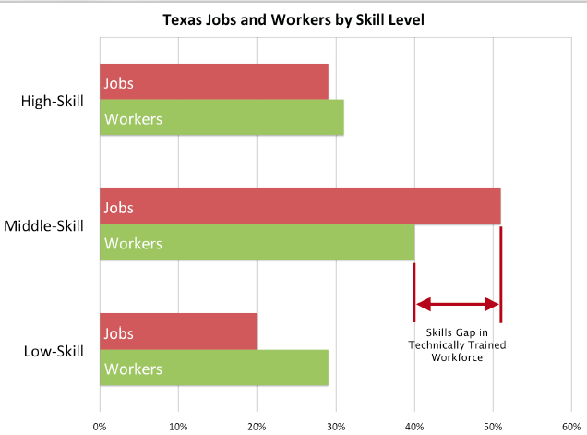
The Skills Gap

Slide 15
Perception Challenges
TWC is working on a statewide “branding” campaign: emphasize careers that don’t require a 4-year degree, do need skills training
We must leverage industry events/awareness though continued collaboration/cooperation
Perception changes begin in elementary, evolve in middle school, mature in high school & thrive in work-based learning opportunities
Students, Parents, Teachers, Advisors, etc.

Slide 16
Opportunities for Progress
Success usually comes when either:
A) an innovative ISD superintendent or college president has a realistic vision for their students
B) employers engage with ISDs and IHEs
Investing time, people, money, equipment, resources to help shape course offerings, direction, priorities, etc.
Collaboration & cooperation happens locally: community-by-community to meet the needs of both employers and students… alignment
- The Blueprint, Toolkit, Case Studies – 6/15

Slide 17
Questions?
512-499-8880 (office)
512-589-2531 (mobile)
Mike@MeroneyPublicAffairs.com

